Slide 1
A Fast Algorithm for Liquid Democracy Problem on Blockchain
Xuepeng Fan⁺, Peng Li*, Yulong Zeng⁺, Xiaoping Zhou*
⁺Autonomous System Research
* The University of Aizu
https://asresearch.io/

Slide 2
1
About Us
2
Introducing Democracy on Blockchain
3
Liquid Democracy on Blockchain
4
Fast Algorithm for Liquid Democracy
5
Evaluation
6
Conclusion

Slide 3
About Us
Autonomous System Research (ASResearch) 由多位从事区块链研究的硕士、博士组成，拥有扎实的学术研究能力，致力于通过坚实的研究进行创新，并通过创新推动整个区块链行业的发展。
分布式系统
密码学
共识机制
经济学
治理
零知识证明
虚拟机

Slide 4
1
About Us
2
Introducing Voting on Blockchain
3
Liquid Voting on Blockchain
4
Fast Algorithm for Liquid Voting
5
Evaluation
6
Conclusion

Slide 5
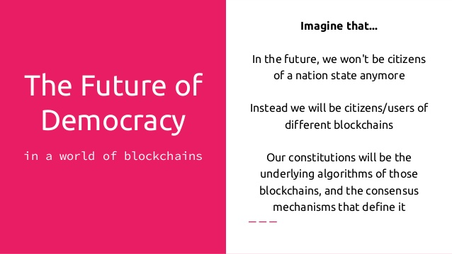
Introducing Democracy on Blockchain
For blockchain community, democracy is quite essential.
We use voting to decide almost everything for blockchain, like PoW mining, DPoS, DAO, BIP, EIP, and etc..
Communities outside blockchain also wants voting with blockchain.

Slide 6
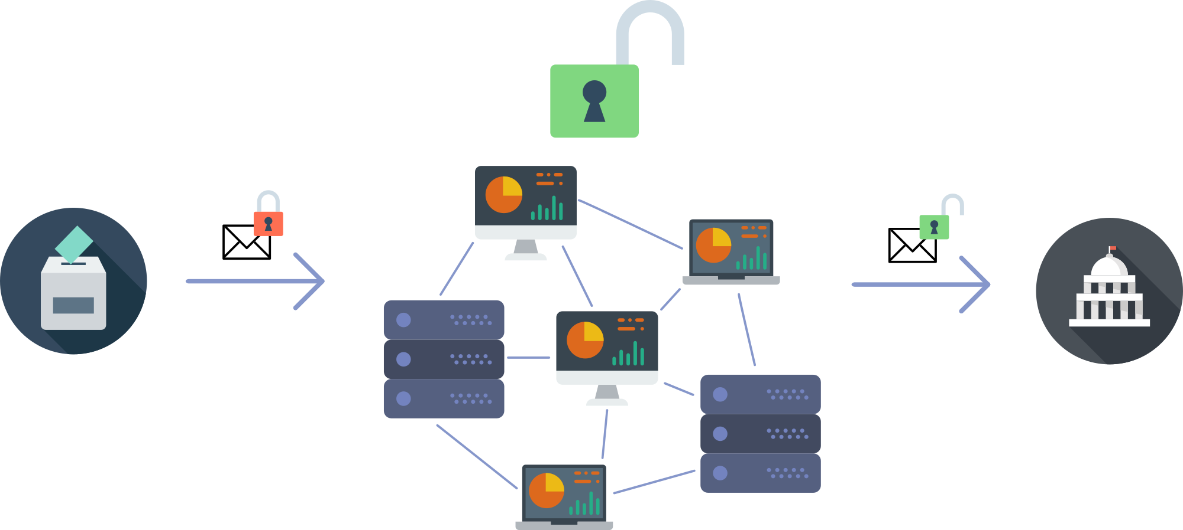
Introducing Democracy on Blockchain
Democracy/Voting on blockchain has many advantages.
Open
Transparent
Self-tallying
Privacy
Yet, different voting mechanisms matter a lot.

Slide 7
Introducing Democracy on Blockchain
Basically, there are 3 different voting/democracy mechanisms.
Direct democracy, like PoW mining
Representative democracy, like DPoS
Liquid Democracy

Slide 8
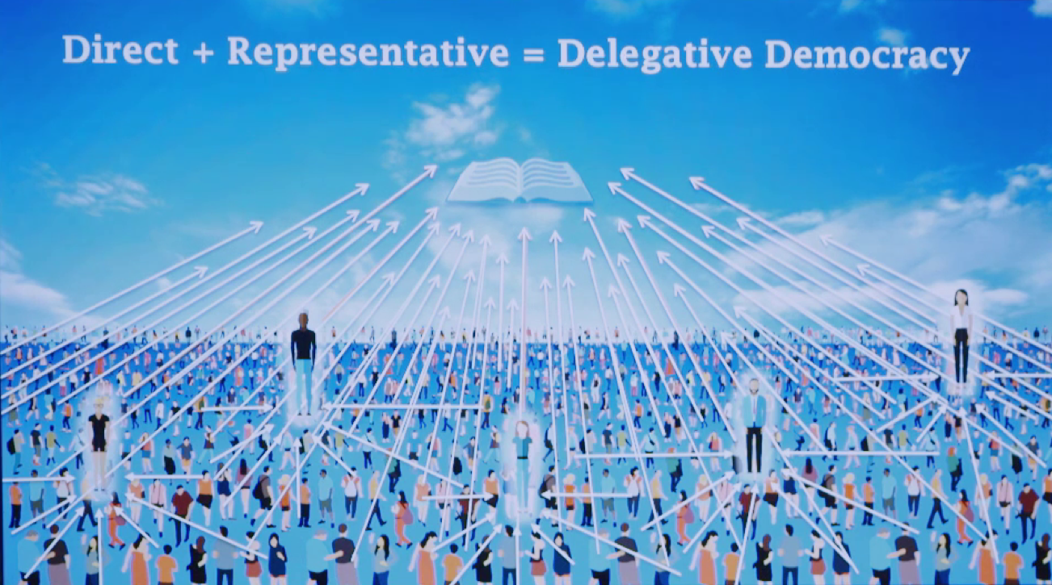

Slide 9
1
About Us
2
Introducing Democracy on Blockchain
3
Liquid Democracy on Blockchain
4
Fast Algorithm for Liquid Democracy
5
Evaluation
6
Conclusion

Slide 10
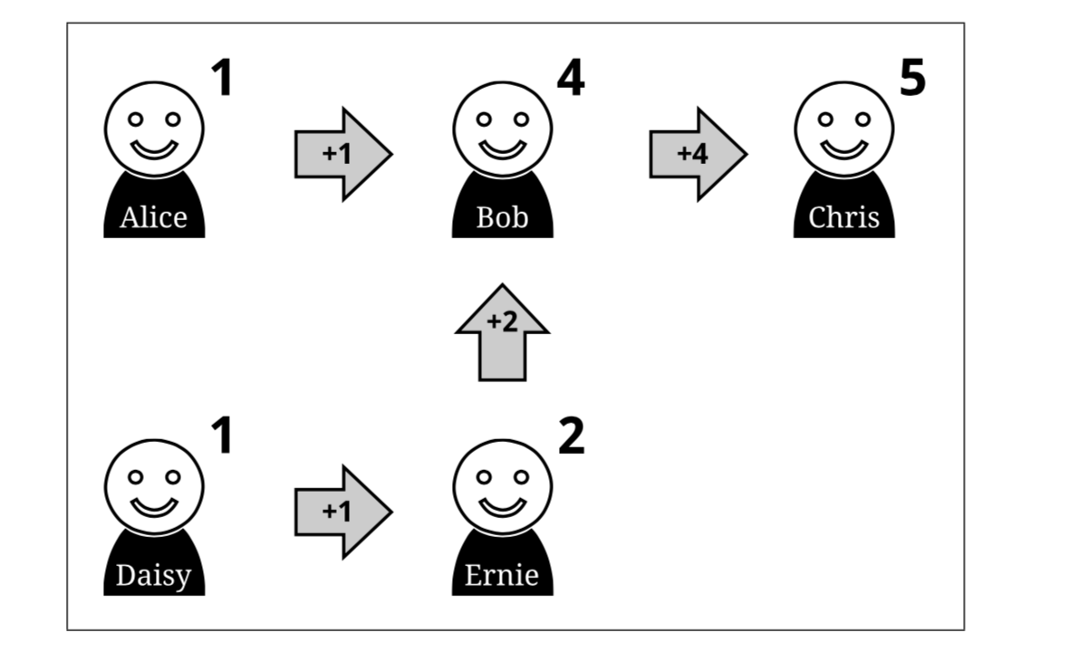
Liquid Democracy
Each voter can select a proxy for his vote
The proxy can further delegate to other people
Creating a (direct) delegate graph
Whenever a delegate votes to a candidate, all his delegators’ (including multi-level) voting powers are also cast to that candidate.
If the delegator dislikes the way in which the proxy voted, they can either vote themselves or pick another delegate for the next vote.

Slide 11
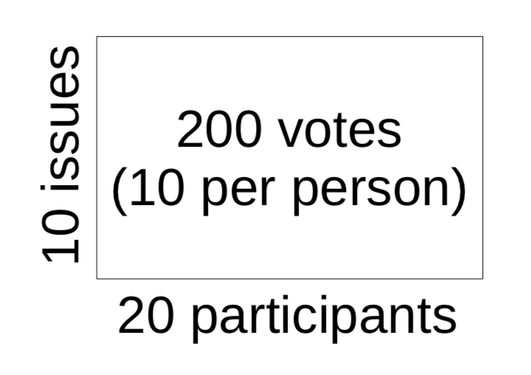
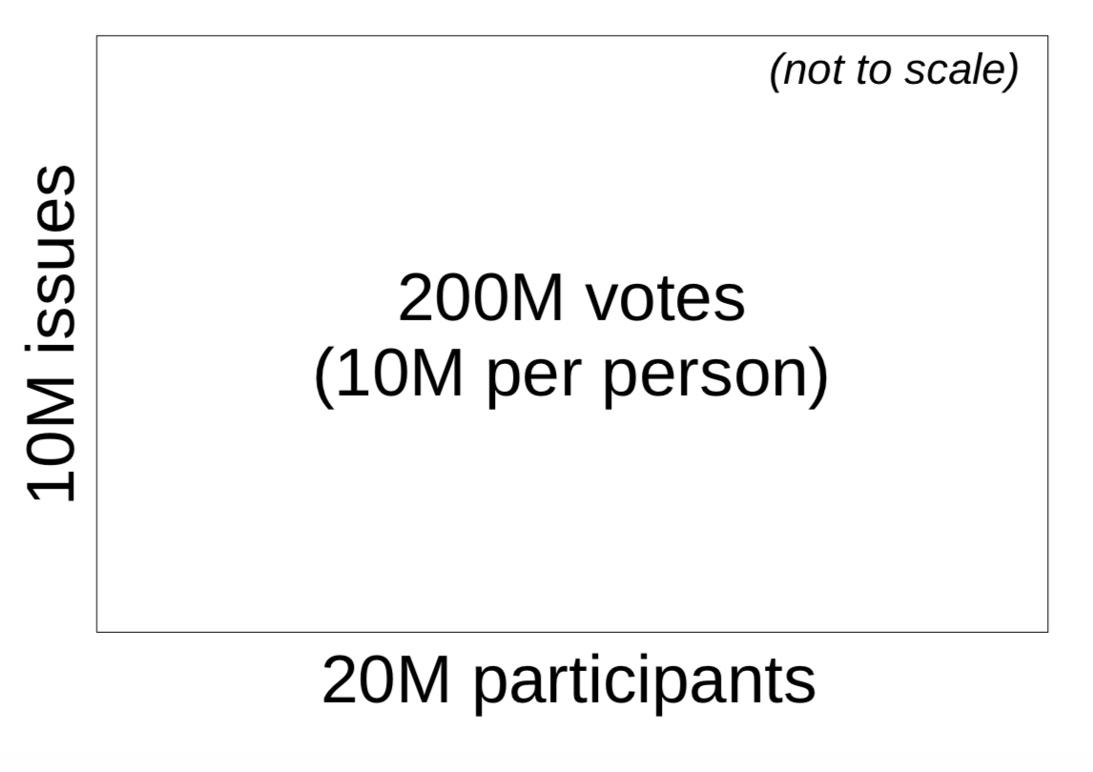
Why Liquid Democracy
Saving time in direct democracy:
Do not have time for fully participation
Can not become expert on every issue.
Ask a friend who knows more.
Get opinion of a trusted expert.
Pure direct democracy may work for a small group...
Liquid democracy allows voters to delegate to different representatives in different areas.
Delegate health issues to my doctor friend
Delegate technology issues to geek friend

Slide 12

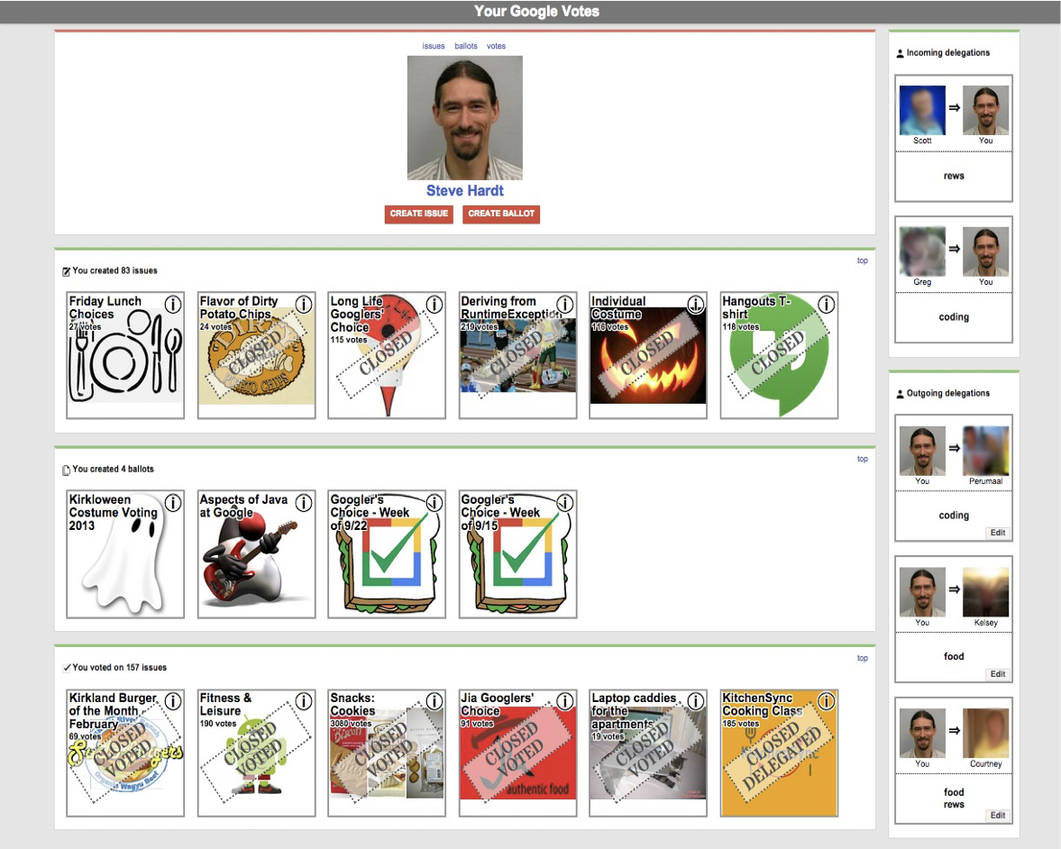
Applications
Google vote Liquid Feedback

Slide 13
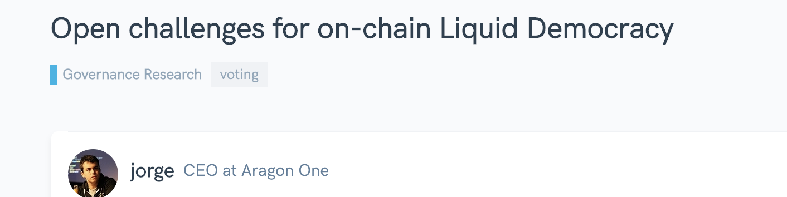
Blockchain
Decentralized and immutable public ledger
Voting system can be deployed through smart contract
Safe, reliable, transparent
Challenge: gas fee limitation
Executing of single instruction of smart contracts consumes gas,
Total consumed gas bounded by Block_gas_limit
Number of instructions less than 1000
Remains open

Slide 14
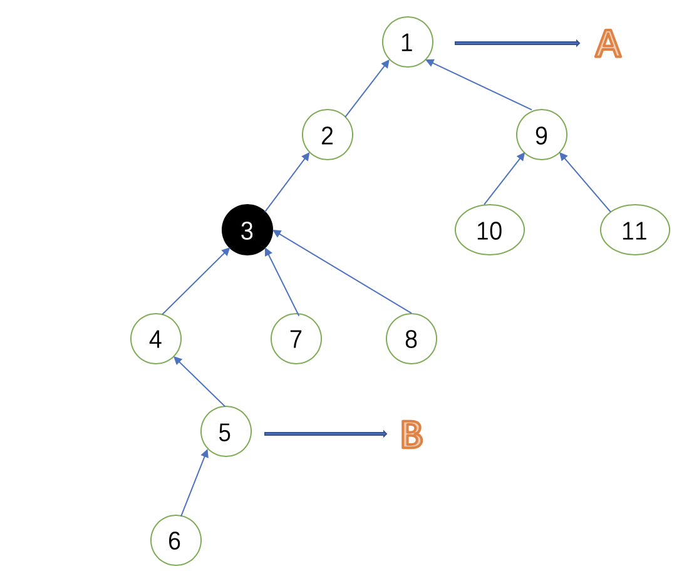
Difficulty: real-time self tally requirement
Suppose 3 votes,
two critical information need:
Actual voting power:
5’s vote reduces 3’s voting power
Vote change to other candidate
3’s vote reduce 1’s voting power
Thus A’s votes are decreased:
Traditional algorithm: forward and backward traversal to obtain the information
O(n) time complexity → n<1000 in practice

Slide 15
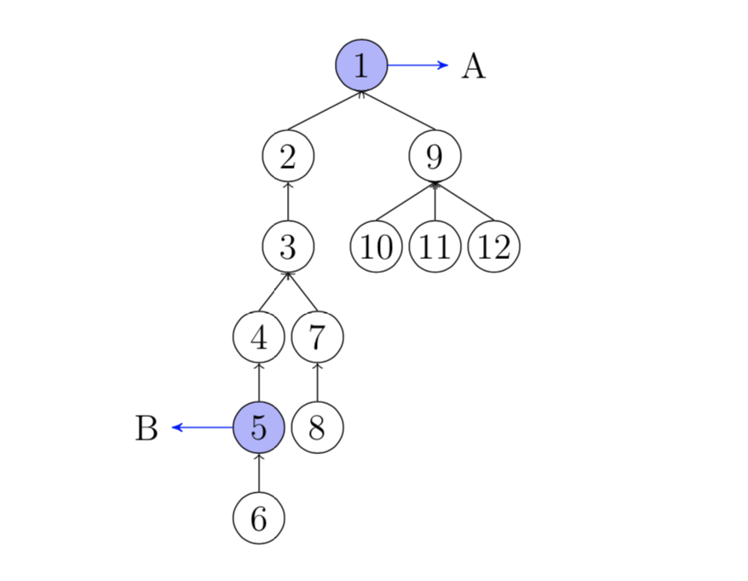
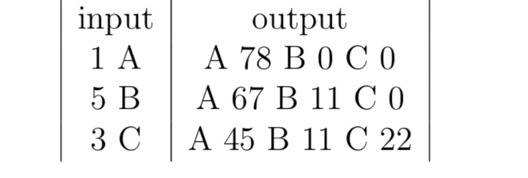
Example
Suppose voter i’s voting power is i
1 votes for A, A increases 78
5 votes for B, B increases 11, A decreases 11
3 votes for C, C increases 22, A decreases 22
Goal: real-time displaying voting status

Slide 16
1
About Us
2
Introducing Democracy on Blockchain
3
Liquid Democracy on Blockchain
4
Fast Algorithm for Liquid Democracy
5
Evaluation
6
Conclusion
Notes:
业务理解（背景趋势、需求痛点、目标（分阶段写清楚））
解决方案（针对各个痛点提出应用场景，及实现方式，引出优化建议； 总结整体技术路线、数据框架 ）
工作进展（本项目组工作开展情况，组织、分工、计划）
建设收益（针对场景总结建设收益）

Slide 17
Preliminary: Problem
n voters, indexed by 1,2,.,..n, m candidates, indexed by A,B,C
Spare period: voters can arbitrarily delegate, undelegate and change delegate.
Prepare period: a holder deploys a voting contract, the delegate graph need to be construct, and each voter’s voting power is determined
Voting period: each voter can send direct voting massage, the voting status need to be updated and displayed according to the rule of liquid democracy.
Voter can not change his delegate in this period

Slide 18
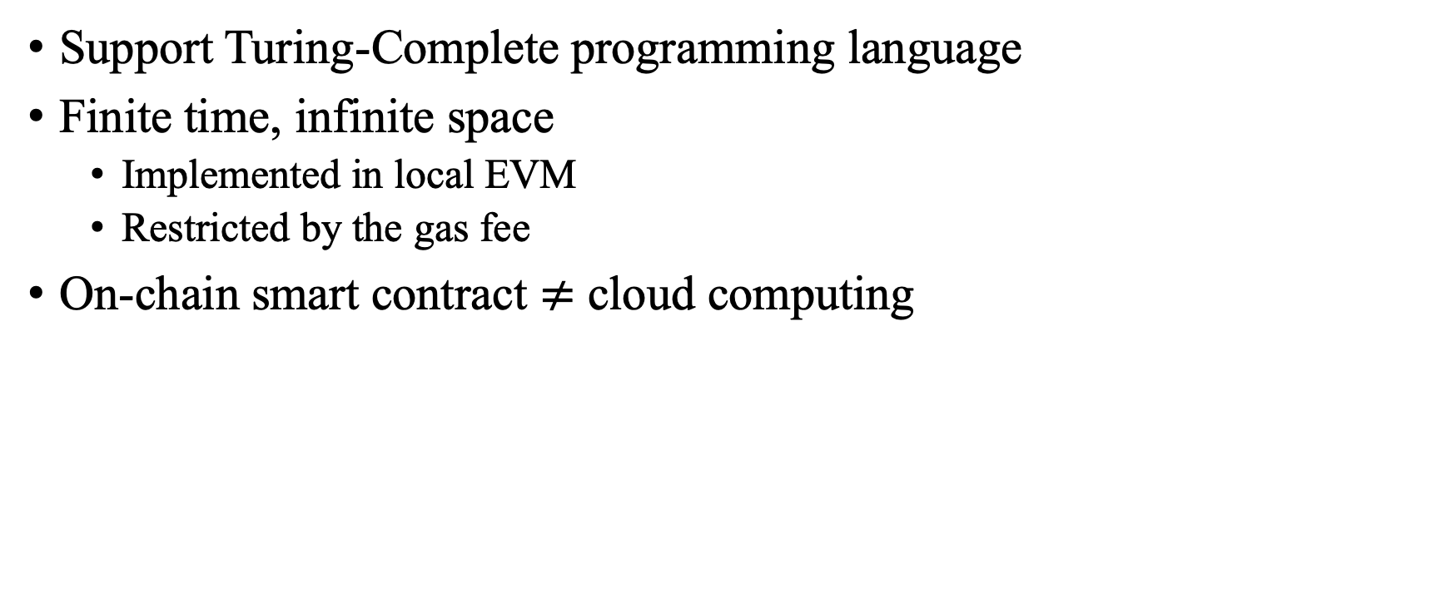
Preliminary: smart contract
Support Turing-Complete programming language
Finite time, infinite space
Implemented in local EVM
Restricted by the gas fee
On-chain smart contract $≠$ cloud computing

Slide 19
Voting Process
Voting creators generate Merkle tree and save the Merkle root onchain for the voting.
Each voter get his voting info, like voting power, and other meta info, and also a Merkle proof for the voting info.
The voting contract will check each ballot and do the self-tallying.

Slide 20
Algorithm: Overview
Maintain the “lost voting power” (LVP)
Actual power=total voting power-LVP
1 votes, nobody LVP change
5 votes, B’s vote +11, voter 2,3,4’s LVP-11
3 votes for C, C’s vote+22(3+…+8-11), 2’s LVP-22
Observation: when a vote votes, nodes’ LVP need to be updated if and only if it is on the path from the voter to the voter’s nearest voted parent (NVP)
When 5 votes, path (5)→4→3→2→(1) should update LVP
When 3 votes, path (3)→2→(1) should update LVP

Slide 21
Core
1. Find the node’s NVP
2. Update the LVP on the path
Solution: interval tree, w.r.t.
Preorder sequence: 1 2 3 … 12
Bracket sequence: 1 2 3 4 5 6 6 5 4 7 8 8 7 3 2 9 10 10 11 11 12 12 9 1
Off-chain initialization
Preorder index, total voting power, index of the bracket sequence
Submit to the contract together with voting message.

Slide 22
Merkel Tree
Hash function h()
Cryptographically hard for inverse
Node’s value: Hash value of the Combination of child nodes
Merkle proof (path):
The brother nodes of the path from a leaf to the root
For data A, proof is (h_{B},h_{CD})
ROOT=h(h_{AB}||h_{CD})
h()
h_{AB}=h(h_{A}||h_{B})
h_{CD}=h(h_{C}||h_{D})
h()
h()
h_{A}
h_{B}
h_{c}
h_{D}

Slide 23
Interval Tree
Each node represents an interval
Root indexed 1, for node k, two children indexed 2k, 2k+1
Use: maintain an array, where the operation is to a successive interval
Update a interval:
Begin at the root, execute recursively
Sperate to sub-intervals such that belongs to the interval of current node
Recursion ends when the interval to be update equals to interval of current node
Recorded by lazy-tag, which means that it is temporarily suspended and will be executed in subsequent operations
O(log n) time complexity

Slide 24
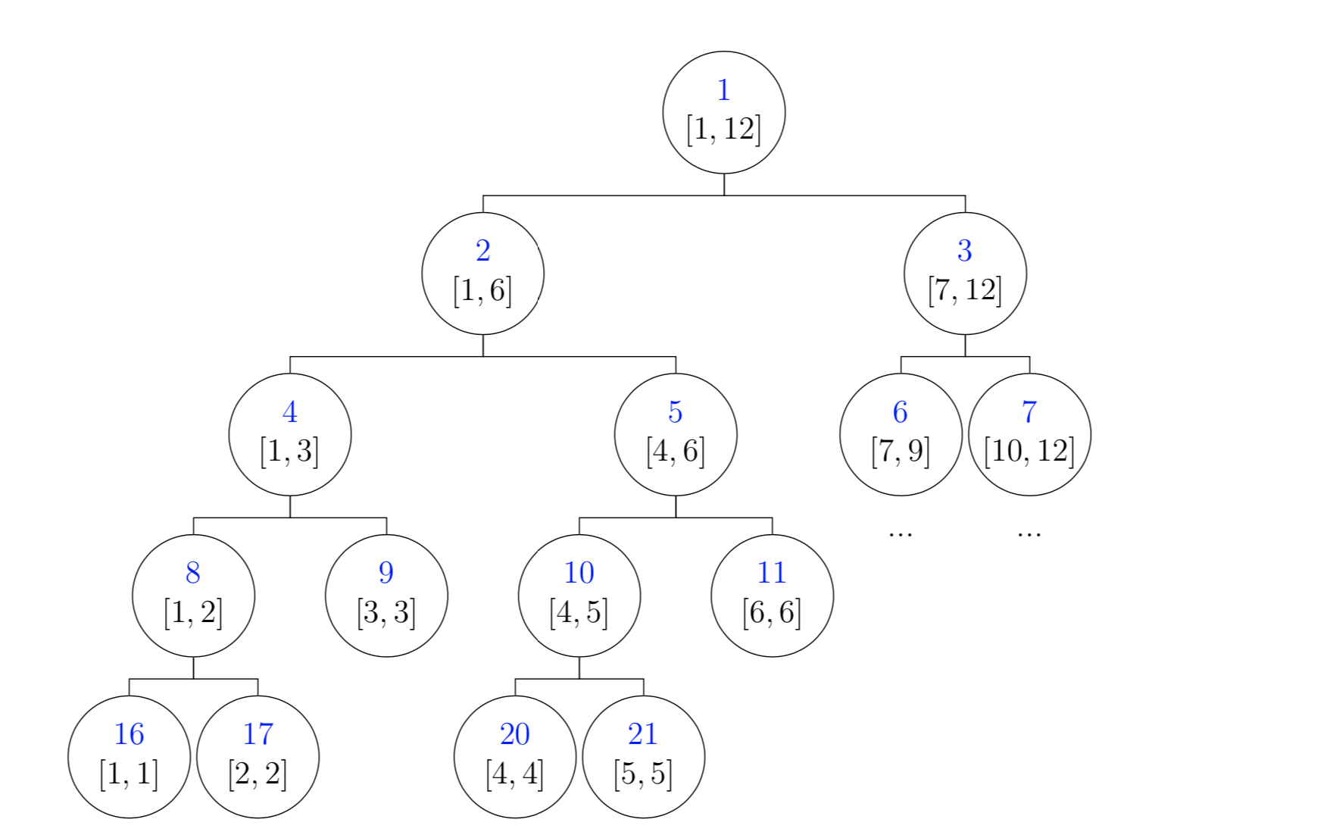
[3,12]
Update [3,12]
[3,6]
[7,12]
Lazy-tag
[3,3]
[4,6]
Lazy-tag
[3,3]
Update

Slide 25
Prepare Period
For each voter involved in the voting:
Snapshot the blockchain by the current height
Construct the delegate tree T
Link each zero-outdegree node to a virtual node
Obtain voters’ voting powers by their stakes from the snapshot
Call Preorder(T.root) for initialization data
Construct the Merkle tree for each voter’s initialization data
For the holder:
Hardcode the Merkle root in the voting contract

Slide 26
Voting Period: main function
For voter: send a voting massage, together with his initialization data
For voting contract: upon receiving a voting massage:
Check the availability
Compute the voter’s LVP
t = voter’s total voting power minus LVP, represents his actual votes.
Find the voter’s NVP, and then update other voters’ NVPs
The candidate of the voter’s NVP decreases by t.
Update the LVPs of the nodes on the path from the voter to the voter’s NVP.

Slide 27
Find the NVP
Observation
A node’s preorder index is always smaller than its children’s.
Preorder indexes of a node’s children are successive to the node’s preorder index.
When a voter votes, only his children’s NVP need to be updated, which should be at least the voter’s preorder index.
Maximum value update w.r.t. to the interval of the node’s children
When 3 votes, use 3 to update 4,5,6,7,8’s NVP.

Slide 28
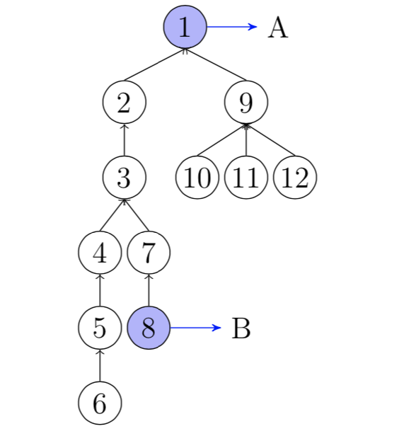
Update the LVP
When 8 votes, path (8)→7→3→2→(1) should update
Not successive
Use bracket sequence
Bracket sequence:
1,2,3,4,5,6,6,5,4,7,8,8,7,3,2,9,10,10,11,11,12,12,9,1
Bracket interval:
[End point’s leftbracket, Start point’s leftbracket]
For 8->1, Bracket interval is index 1-11
1, 2, 3, 4, 5, 6, 6, 5, 4, 7, 8

Slide 29
Update the LVP (cont’)
Observation: for nodes on the path, they occur exact once in the bracket interval; for node outside the path, they occur twice or do not occur
Update LVP by adding the value to the “s” value of the bracket interval
Only the node on the path increases LVP
When 8 votes, s[1-11]+=8
Interval tree w.r.t. the bracket sequence
1, 2, 3, 4, 5, 6, 6, 5, 4, 7, 8
node.LVP = s[node.leftbracket] − s[node.rightbracket]

Slide 30
1
About Us
2
Introducing Democracy on Blockchain
3
Liquid Democracy on Blockchain
4
Fast Algorithm for Liquid Democracy
5
Evaluation
6
Conclusion

Slide 31
Experiment
https://github.com/freeof123/liquid-voting/tree/master/ether-eval
Voting by delegate chain tail.
Voting by delegate chain root.

Slide 32
1
About Us
2
Introducing Democracy on Blockchain
3
Liquid Democracy on Blockchain
4
Fast Algorithm for Liquid Democracy
5
Evaluation
5
Conclusion

Slide 33
Conclusion
O(log n) on-chain time complexity processing each voting massage
O(n) off-chain time complexity for initialization
There maybe more problems like this, initiation data is submitted to the contract together with the input data, and is computed with O(log n) time complexity

Slide 34
Thanks!
https://arxiv.org/abs/1911.08774

